Slide 1
Digital Business and E-Commerce Management
Lesson 6
Supply Chain Management

Slide 2
Supply Chain Management
At the end of this lesson, you will be able to
Identify the main elements of supply chain management
1
Assess the potential of information system in support of supply chain management
2

Slide 3
Activity 6.1
Refer to your book for Activity 6.1

Slide 4
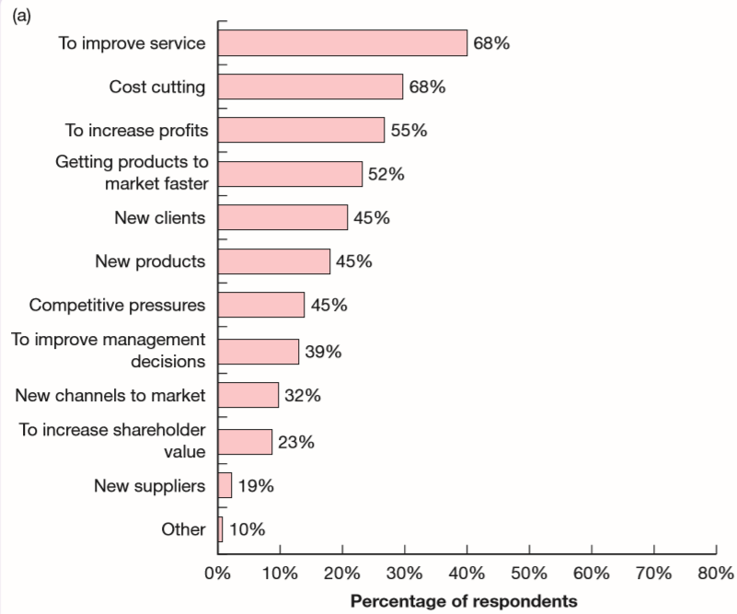
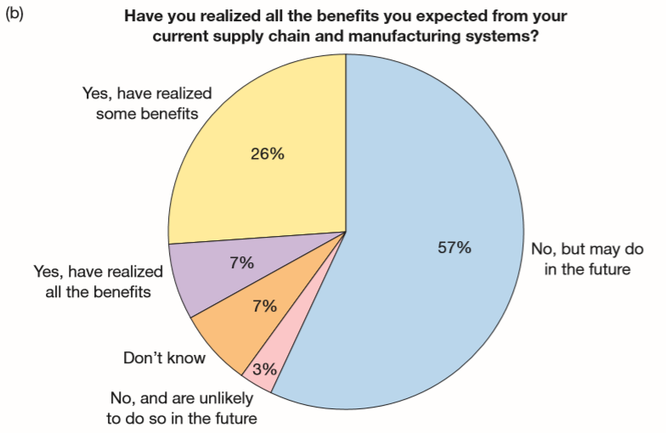
Supply Chain Management (Benefits of SCM)
a. Benefits of Supply Chain Management
b. Realization of benefits

Slide 5
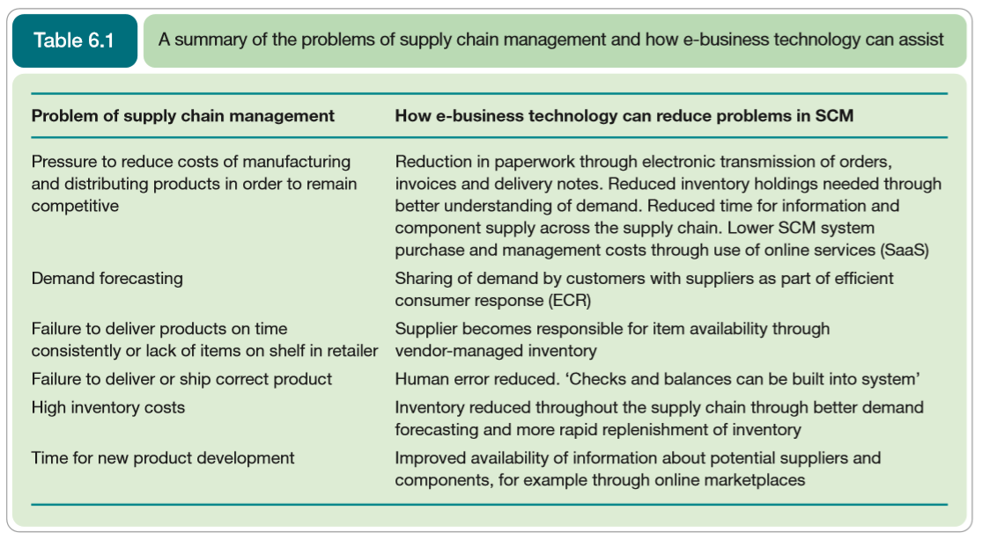
Supply Chain Management (Problems of SCM)
We can also review the benefits of SCM from the perspective of problems that can occur in a supply chain and consider how digital business technology can assist.

Slide 6
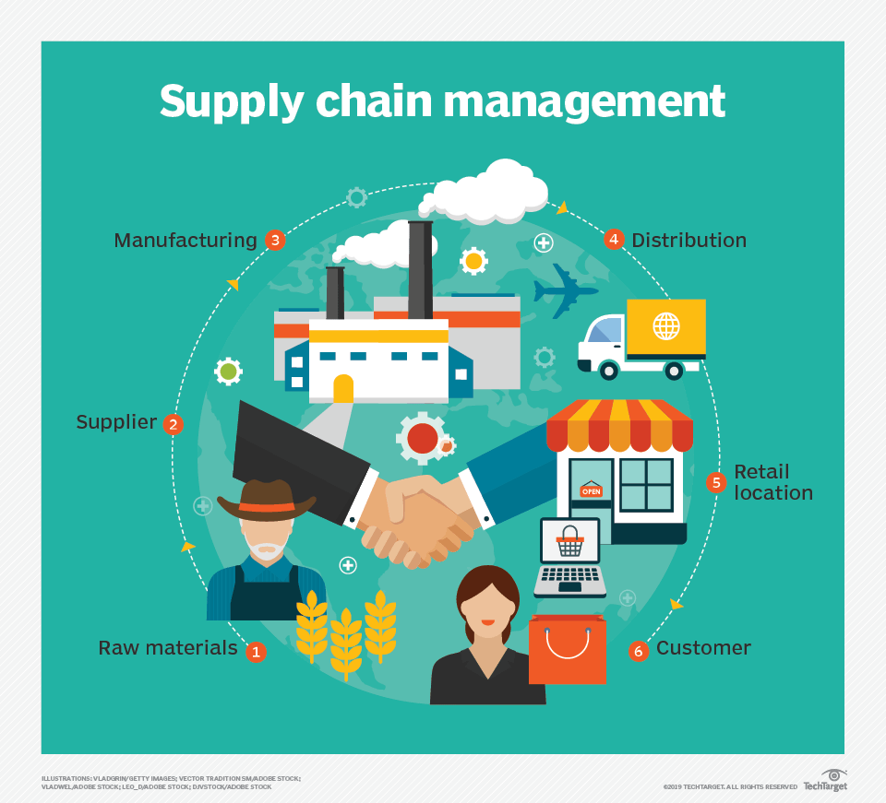
Supply Chain Management (What is SCM?)
The coordination of all supply activities of an organization from its suppliers and partners to its customers.
For most commercial and not-for-profit organizations we can distinguish between upstream supply chain activities which are equivalent to buy-side e-commerce and downstream supply chain activities which correspond to sell-side e-commerce.

Slide 7
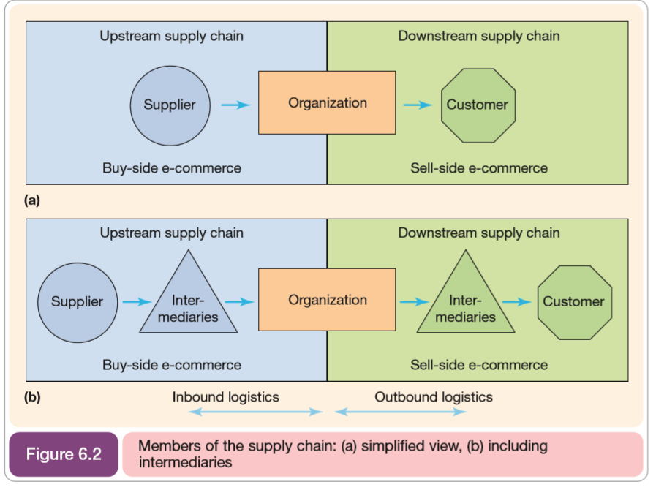
Supply Chain Management (What is SCM?)
Technology is vital to supply chain management since managing relationships with customers, suppliers
and intermediaries is based on the flow of information and the transactions between these parties. This emphasis is about reducing operational costs and so increasing profitability.

Slide 8
Activity 6.2
Refer to your book for Activity 6.2

Slide 9
Supply Chain Management (Example of how technology supports SCM)
A good example of how the introduction of information systems can be used to improve supply chain management is provided by BHP Steel (now BlueScope Steel, www.bluescopesteel.com.au), an Australian firm.
Its use of PC-based technology for supply chain management and digital business represents a change of emphasis rather than a radically new approach.

Slide 10
Supply Chain Management (Simple model of SCM)
An organization’s supply chain can be viewed from a systems perspective as the:
acquisition of resources (inputs)
their transformation (process) into products and services (outputs)
which are then delivered to customers.

Slide 11

Supply Chain Management (Simple model of SCM)
Such a perspective indicates that as part of moving to digital business, organizations can review the transformation process and optimize it in order to deliver products to customers with greater efficiency and lower cost.

Slide 12
Activity 6.3
Refer to your book for Activity 6.3

Slide 13
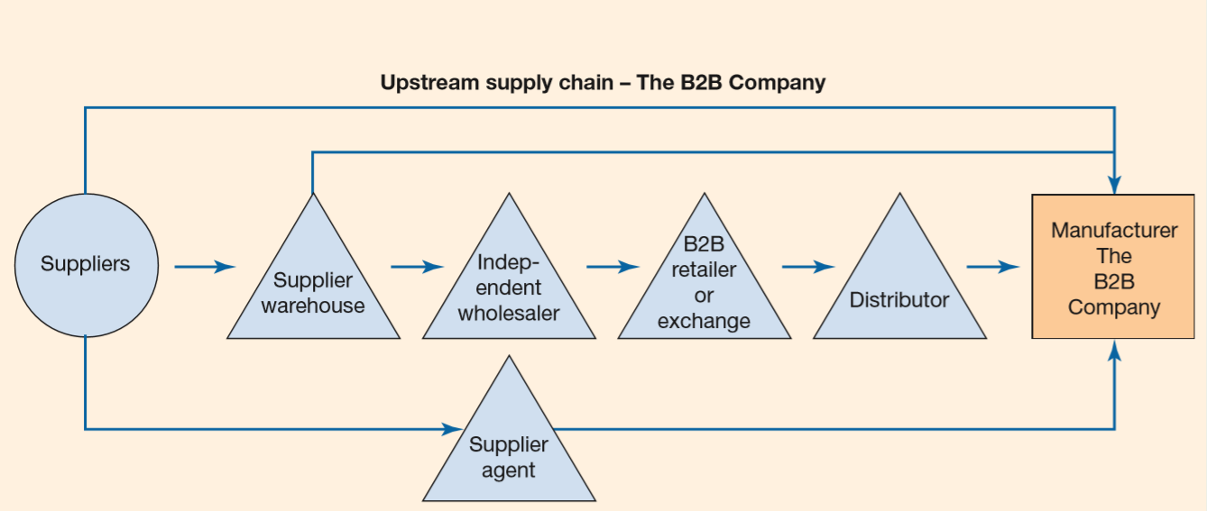
Supply Chain Management (Typical SCM for B2B company)

Slide 14
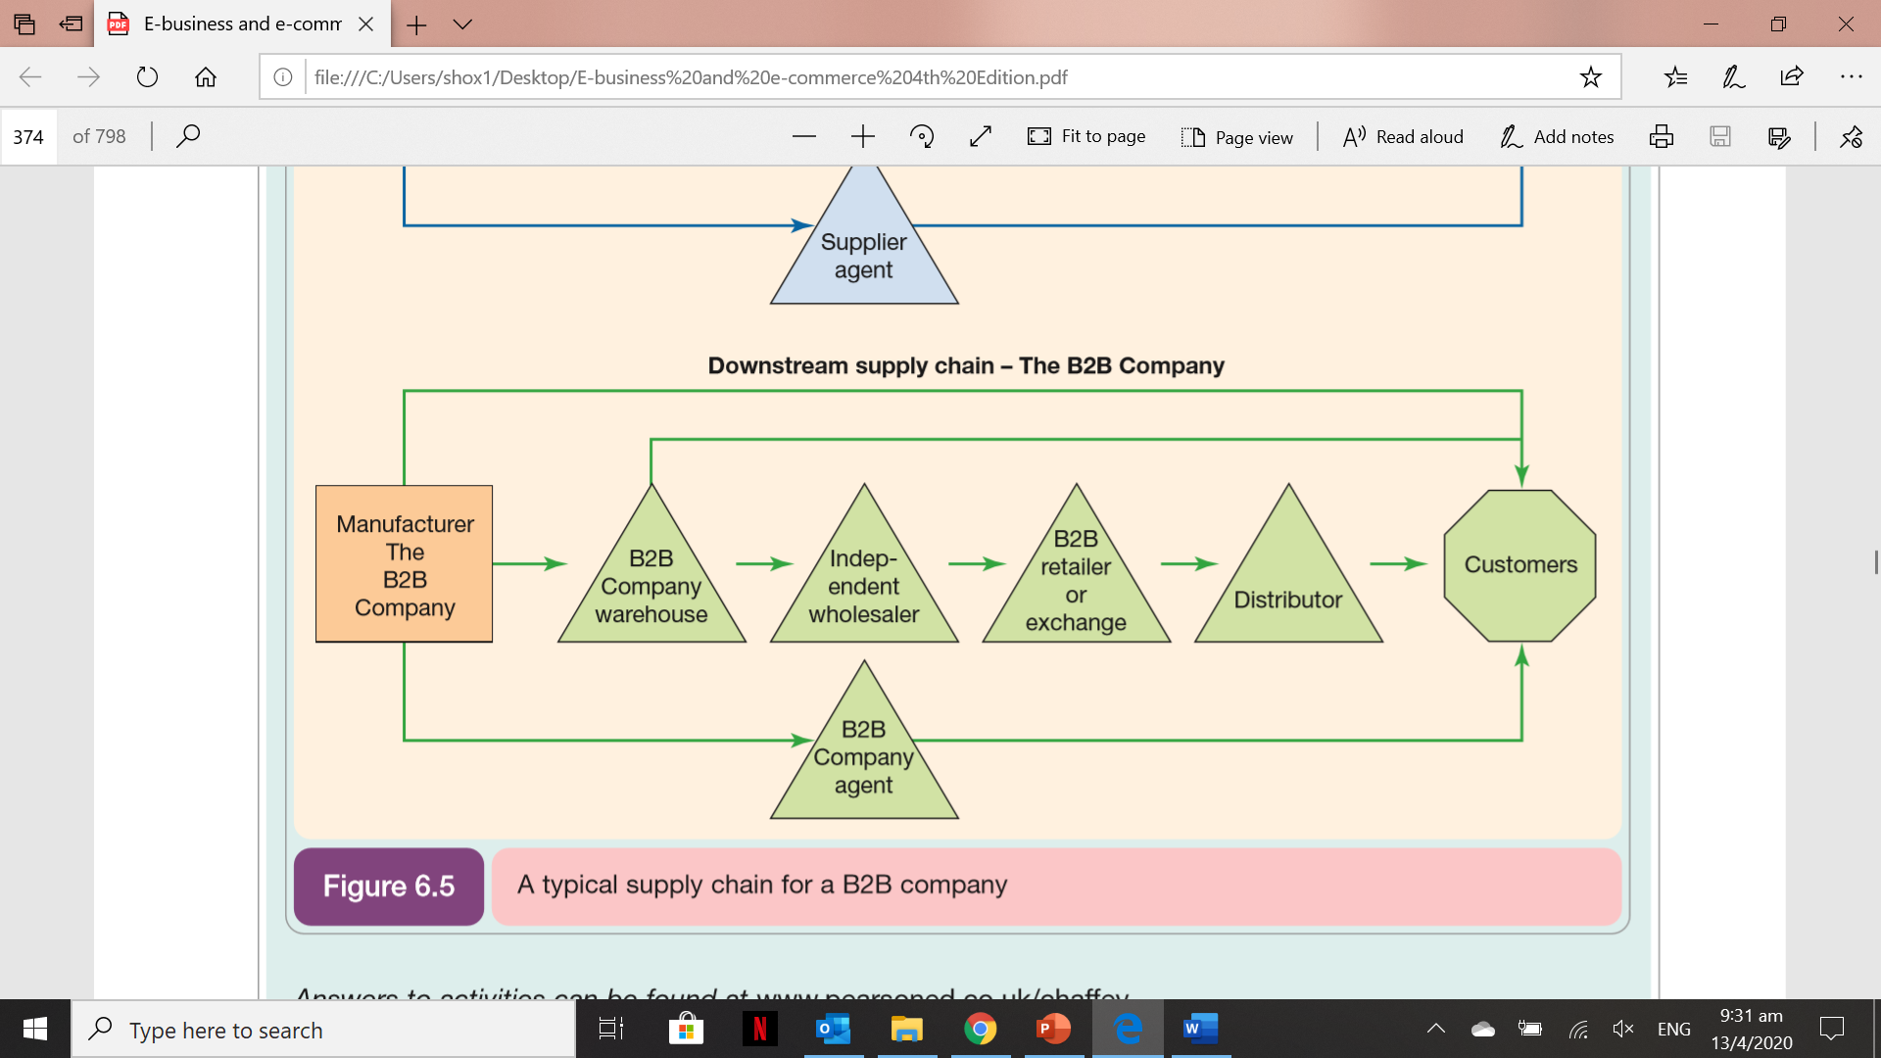
Supply Chain Management (Typical SCM for B2B company)

Slide 15
Activity 6.4
Refer to your book for Activity 6.4

Slide 16
Supply Chain Management (Push and Pull Supply Chain model)
Push Supply Chain
- A supply chain that emphasizes distribution of a product to passive customers.
Pull Supply Chain
- An emphasis on using the supply chain to deliver value to customers who are actively involved in product and service specification.

Slide 17
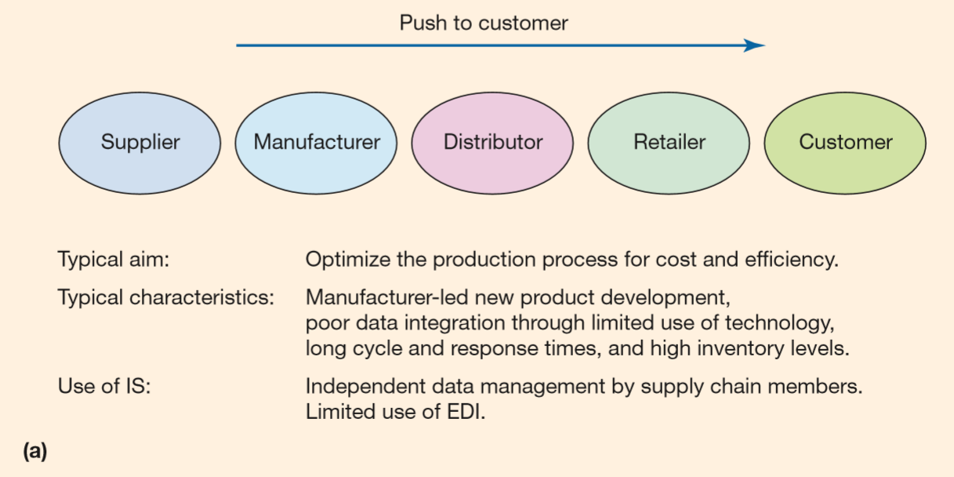
Supply Chain Management (Push and Pull Supply Chain model)

Slide 18
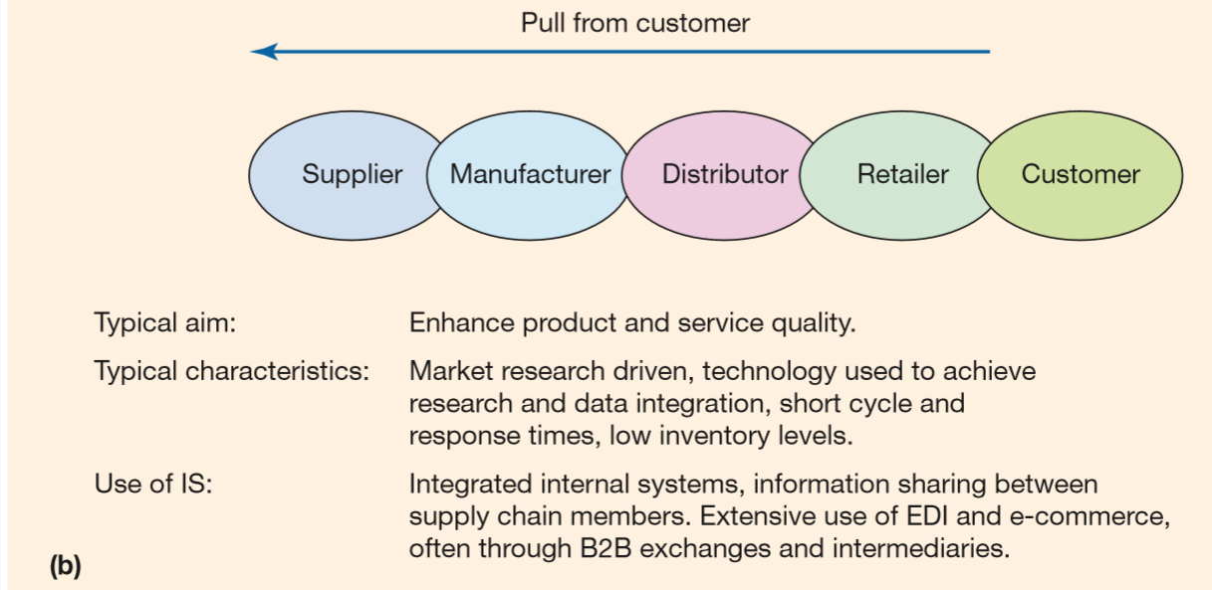
Supply Chain Management (Push and Pull Supply Chain model)

Slide 19
Activity 6.5
Refer to your book for Activity 6.5

Slide 20
Technology options and standards for SCM (Data Transfer Options and Standards)
EDI – method exchanging orders, delivery notes and invoices between two organization
XML- or XML-EDI-based data transfer perhaps through a marketplace hub enables more sophisticated one-to-many data transfers such as a request for orders being transmitted to potential suppliers.
Middleware or software used to integrate or translate requests from external systems
Manual e-mail orders or online purchase through a traditional web-based e-commerce store for B2B

Slide 21
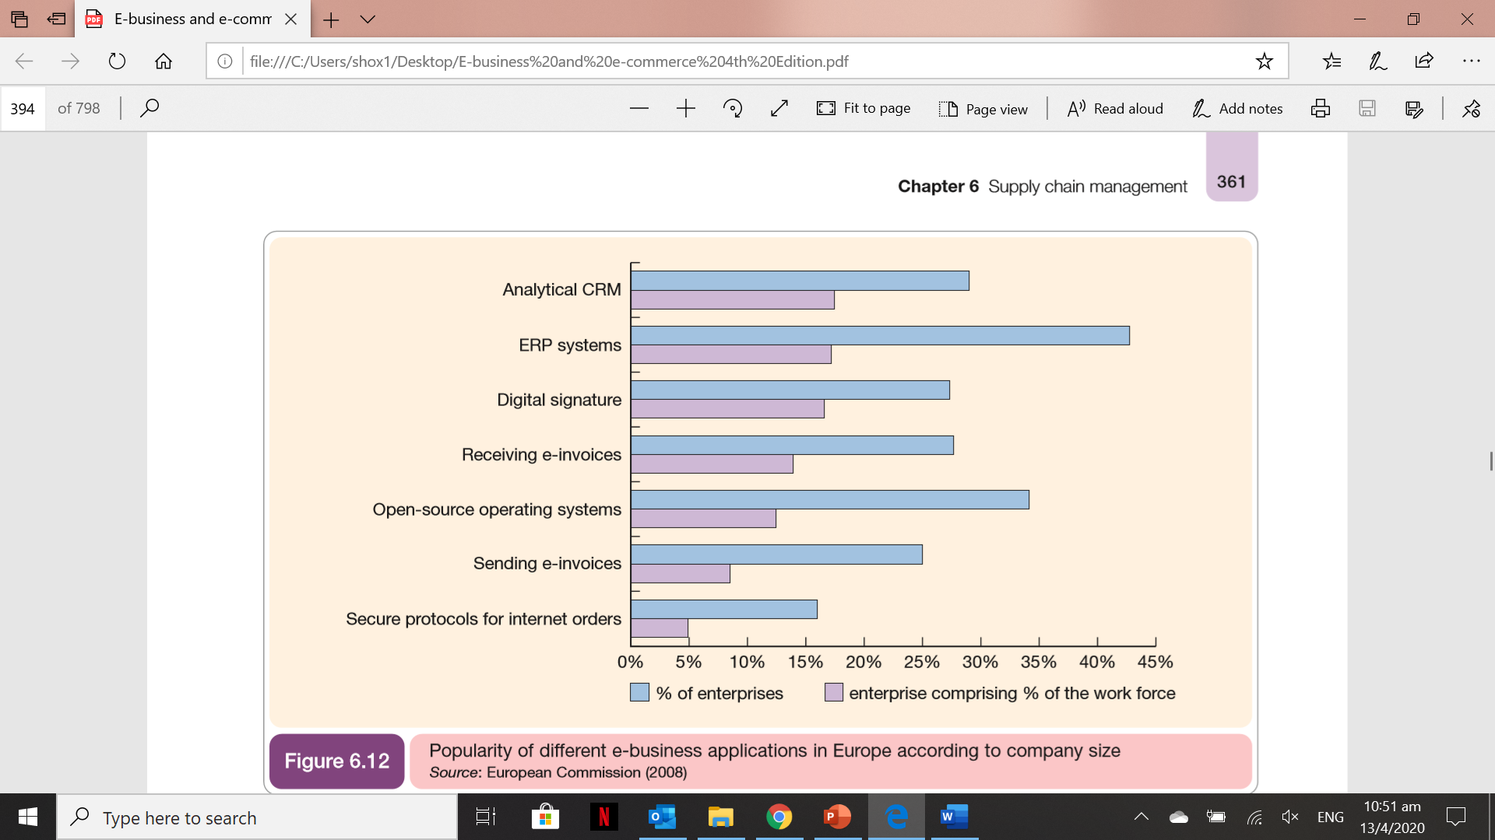
Technology options and standards for SCM (Adoption rates of digital business applications)
Popularity of different digital business applications in Europe according to company size

Slide 22
Technology options and standards for SCM (Benefits of E-SCM with respect to typical B2B company)
Increased efficiency of individual processes
Reduced complexity of the supply chain
Improved data integration between elements of the supply chain
Reduced cost through outsourcing
Innovation

Slide 23
Technology options and standards for SCM (An alternative perspective on the benefits is to look at the benefits that technology can deliver to customers at the end of the supply chain. For the B2B company these could include: )
Increased convenience through 24 hours a day, 7 days a week, 365 days a year ordering
Increased choice of supplier leading to lower costs
Faster lead times and lower costs through reduced inventory holding
The facility to tailor products more readily
Increased information about products and transactions such as technical data sheets and order histories

Slide 24
Technology options and standards for SCM (IS Infrastructure for SCM)
Information systems need to deliver supply chain visibility to different parties who need to access the supply chain information of an organization, whether they be:
employees within the organization
suppliers
logistics service providers
customers
Supply Chain Visibility
Access to up-to-date, accurate, relevant information about supply chain processes to different stakeholders.

Slide 25
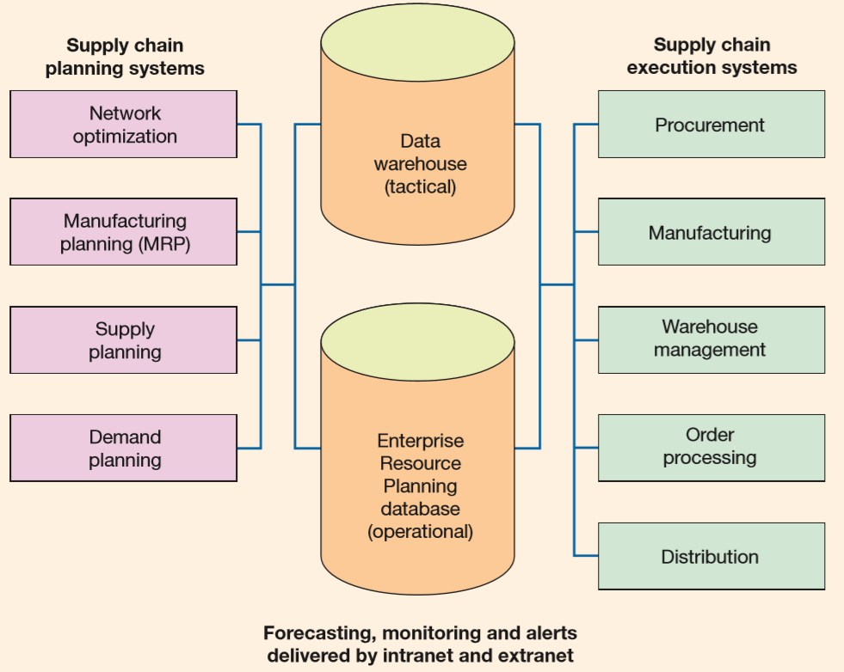
Technology options and standards for SCM (Typical IS infrastructure for SCM)
Information needed by managers to intervene in the supply chain process when problems occur is delivered as alerts or through continuous monitoring across secure private intranets or extranets used to link to partners.

Slide 26
Activity 6.6
Refer to your book for Activity 6.6

Slide 27
Supply Chain Management Implementation (Data Standardization and exchange)
The difficulties of exchanging information between incompatible systems using nonstandard formats which can lead to the rekeying of information has been a barrier limiting the adoption of SCM.

Slide 28
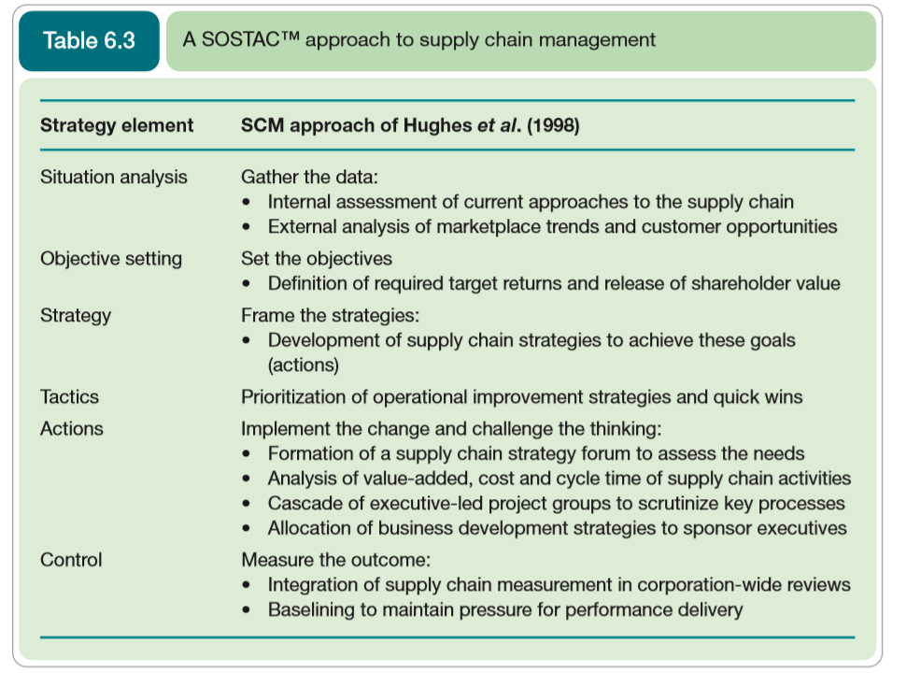
Supply Chain Management Implementation (SCM Strategy Process)
Strategies for supply chain improvement have been categorized by Hughes et al. (1998) according to the scope of change and the speed of change.

Slide 29
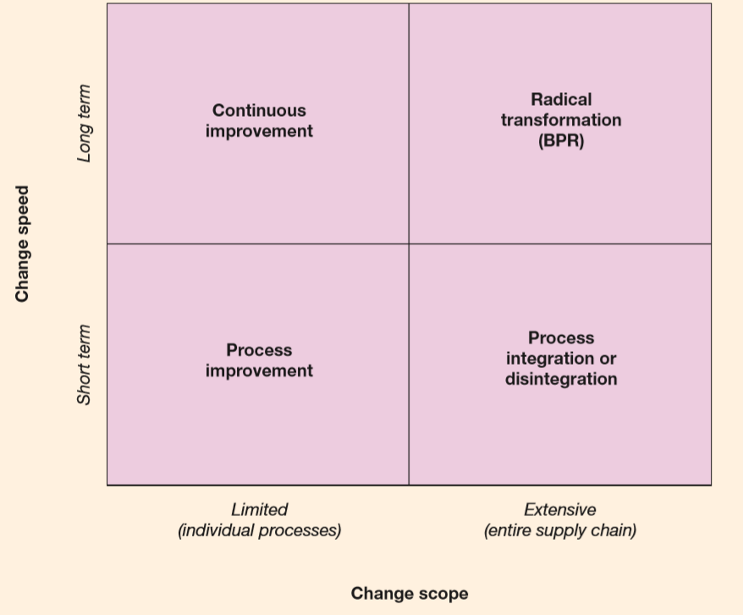
Supply Chain Management Implementation (Alternative strategies for modification of digital business supply chain)

Slide 30
Supply Chain Management Implementation (Goal-setting and performance management for e-SCM)
To manage e-SCM effectively, the types of benefits such as time and cost saving and improve service to customers should be developed into a performance management framework.

Slide 31
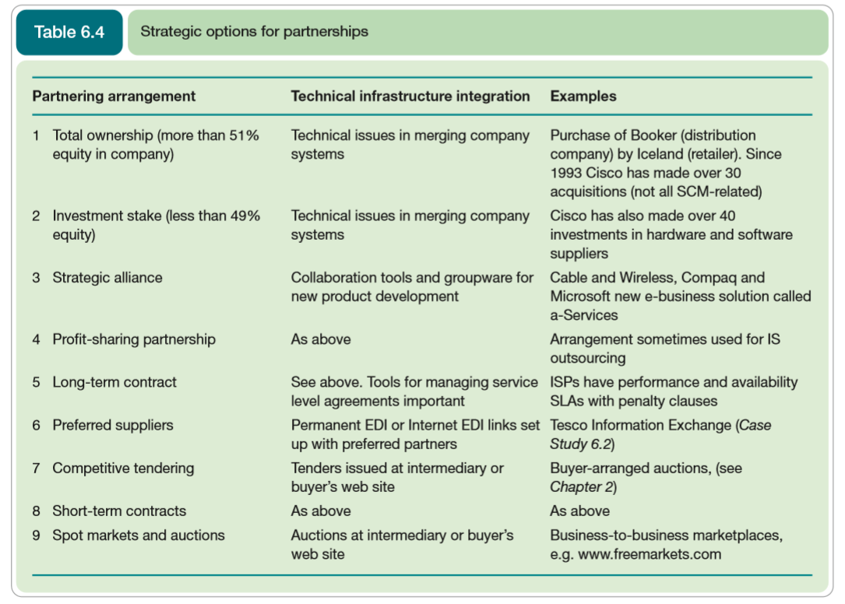
Supply Chain Management Implementation (Goal-setting and performance management for e-SCM)
Presents some strategic options for partnerships in order of increasing control and ownership over the process by the organization.

Slide 32
Activity 6.7
Refer to your book for Activity 6.7

Slide 33
Self-Assessment Questions
Refer to Activity booklet for questions which will help you review the topics covered in this lesson.

